Slide 1
Intro to ASP.NET Core
Daniel Roth & Shayne Boyer
Microsoft

Slide 2


Introductions
Daniel Roth
@danroth27
Shayne Boyer
@spboyer

Slide 3
Introductions
How many of you are new to .NET?
How many of you are new to ASP.NET?
How many of you are familiar with ASP.NET MVC?
How many of you were there when .NET 1.0 was released?
How many of you primarily write in C#? VB? F#? Java? JavaScript? Python? Ruby? Erlang? Something else?

Slide 4
Outline
Time | Title | Summary | Presenter
9:00 AM - 9:30 AM | Session #1: Introduction to the .NET Core SDK |  | Dan
9:30 AM - 10:00 AM | Session #3: ASP.NET Core Basics |  | Dan
10:00 AM - 10:45 AM | Lab #1, #3, #4, #5 | Get bits installed, create first app, ASP.NET Core basics
10:45 AM - 11:00 AM | Break
11:00 AM - 11:30 AM | Session #2: MVC Applications with ASP.NET Core |  | Dan
11:30 AM - 12:15 PM | Lab #2 | MVC basics
12:15 PM - 1:15 PM | Lunch
1:15 PM - 1:30 PM | Session #6: Razor, Tag Helpers |  | Shayne
1:30 PM - 2:00 PM | Lab #6 | Working with Tag Helpers
2:00 PM - 2:30 PM | Break
2:30 PM - 3:15 PM | Session #7 & #8: Web APIs & deploy to Azure |  | Shayne
3:15 PM - 3:45 PM | Lab #7 & #8 | MVC Web API and Deploy app to azure
3:45 PM - 4:00 PM | Summary & Conclusion

Slide 5
Workshop resources
Labs:
https://github.com/jongalloway/aspnetcore-workshop
Bits:
https://github.com/jongalloway/aspnetcore-workshop/blob/master/README.md
Docs:
https://docs.microsoft.com/en-us/dotnet/articles/core
https://docs.microsoft.com/aspnet/core

Slide 6
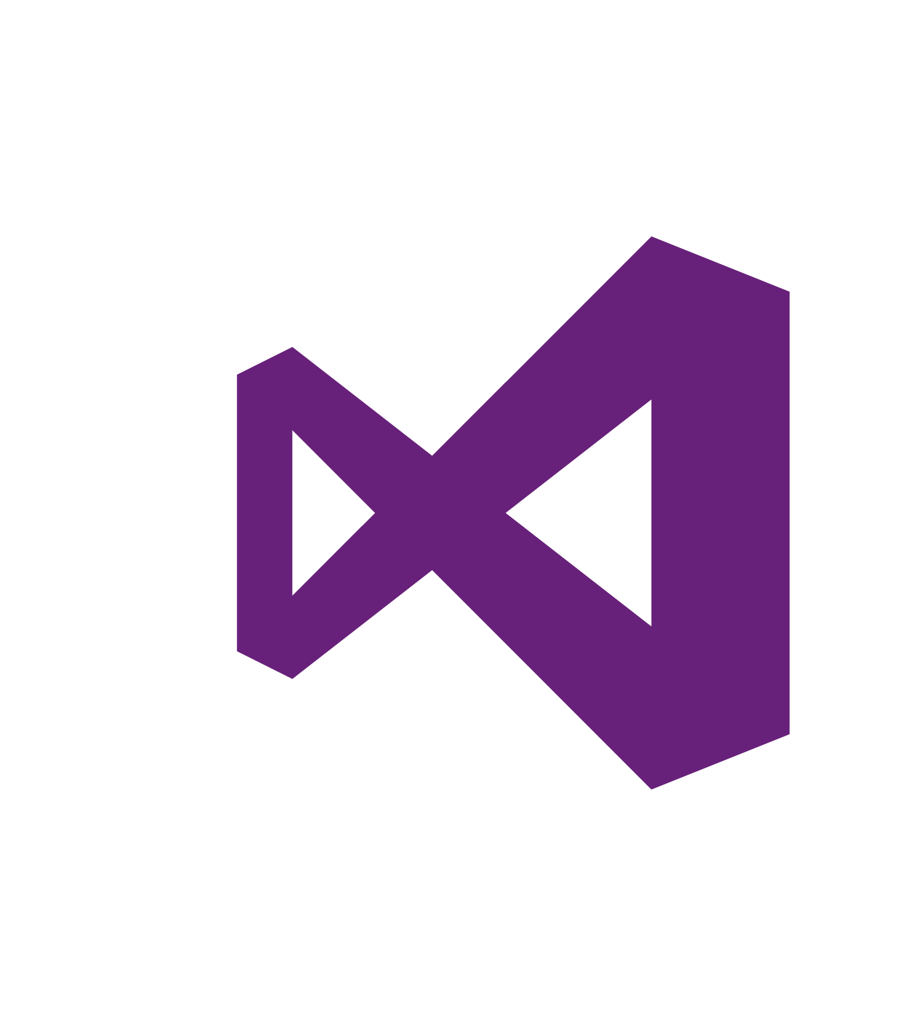
.NET platform
DESKTOP
.NET FRAMEWORK
WINDOWS UWP
.NET CORE
ASP.NET
MOBILE
CLOUD
XAMARIN
TOOLS
Visual Studio
.NET STANDARD LIBRARY
Visual Studio for Mac
COMMON INFRASTRUCTURE
Visual Studio Code
Compilers
Languages
Runtime components

Slide 7
.NET Core -- Cross-platform services
DESKTOP
.NET FRAMEWORK
WINDOWS UWP
.NET CORE
ASP.NET
MOBILE
CLOUD
XAMARIN
TOOLS
Visual Studio
.NET STANDARD LIBRARY
Visual Studio for Mac
COMMON INFRASTRUCTURE
Visual Studio Code
Compilers
Languages
Runtime components

Slide 8

.NET Core
Cross-platform
Windows, Linux and macOS

Slide 9
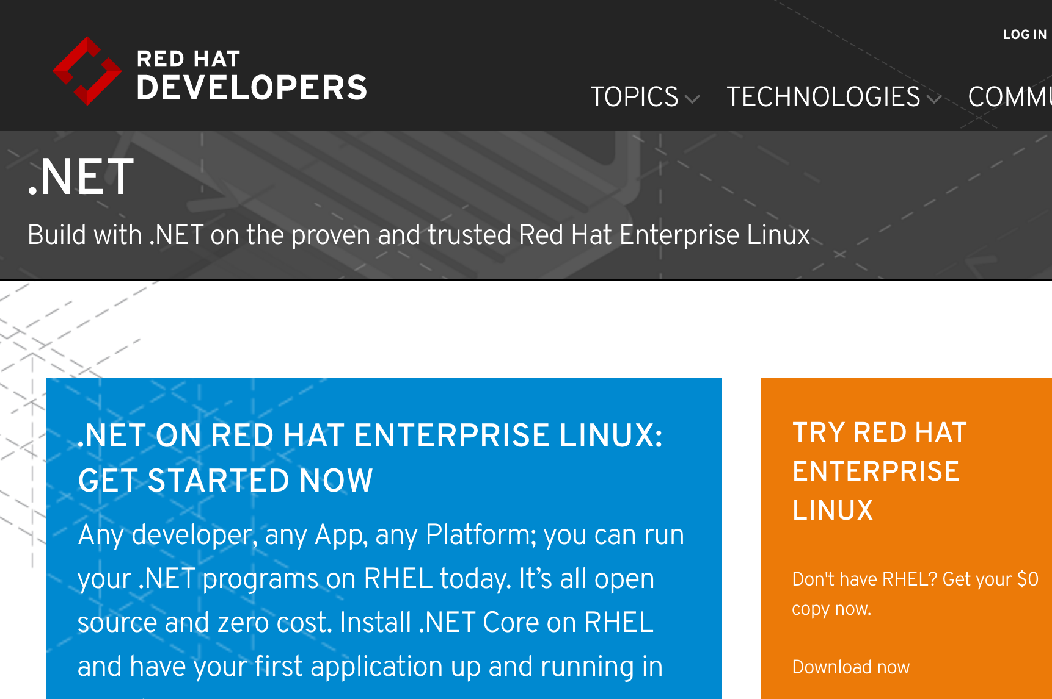
http://redhatloves.net

Slide 10
Supported OSes
Windows
Windows 7+
Server 2008 R2 SP1+
Server 2016 (incl. Nano)
macOS
Sierra
Linux
RHEL
Fedora
Centos
Debian
Ubuntu
Linux Mint
openSUSE
Oracle Linux

Slide 11

.NET Core
Cross-platform
Windows, Linux and macOS
Fast
ASP.NET Core on .NET Core is 4x faster than Node.js in TechEmpower benchmark

Slide 12
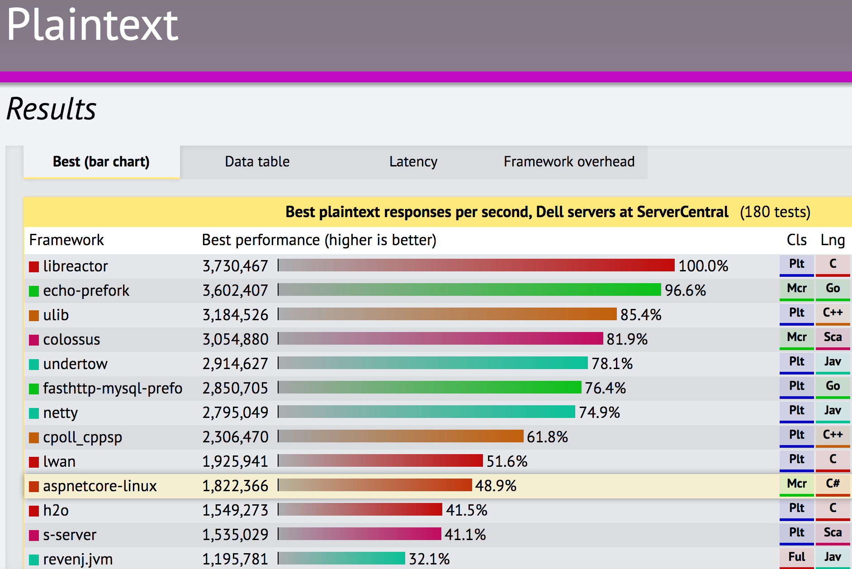
TechEmpower Framework Benchmarks – Round 13 – PlainText
https://techempower.com/benchmarks/

Slide 13

.NET Core
Cross-platform
Windows, Linux and macOS
Fast
ASP.NET Core on .NET Core is 4x faster than Node.js in TechEmpower benchmark
Lightweight
No impact deployment and a modular development model perfect for containers

Slide 14
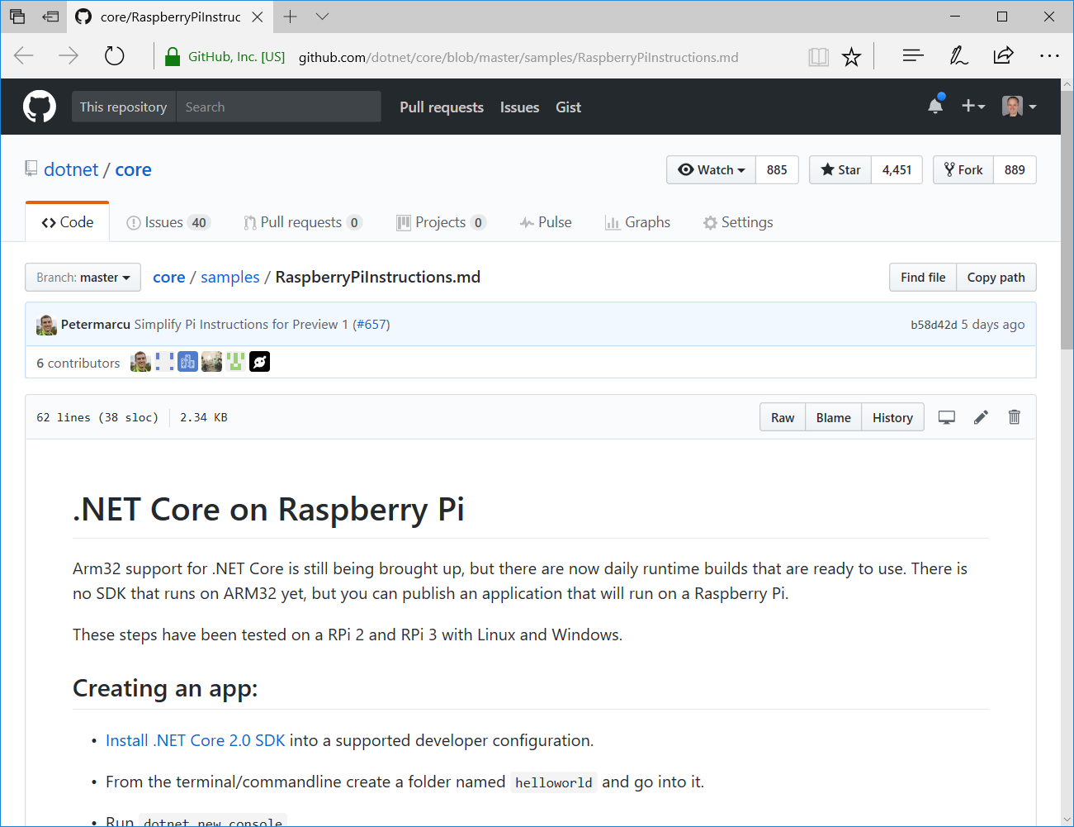
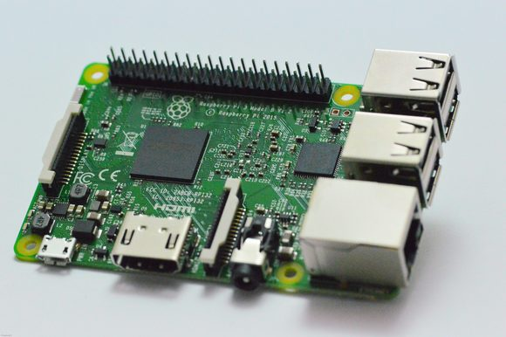

Slide 15
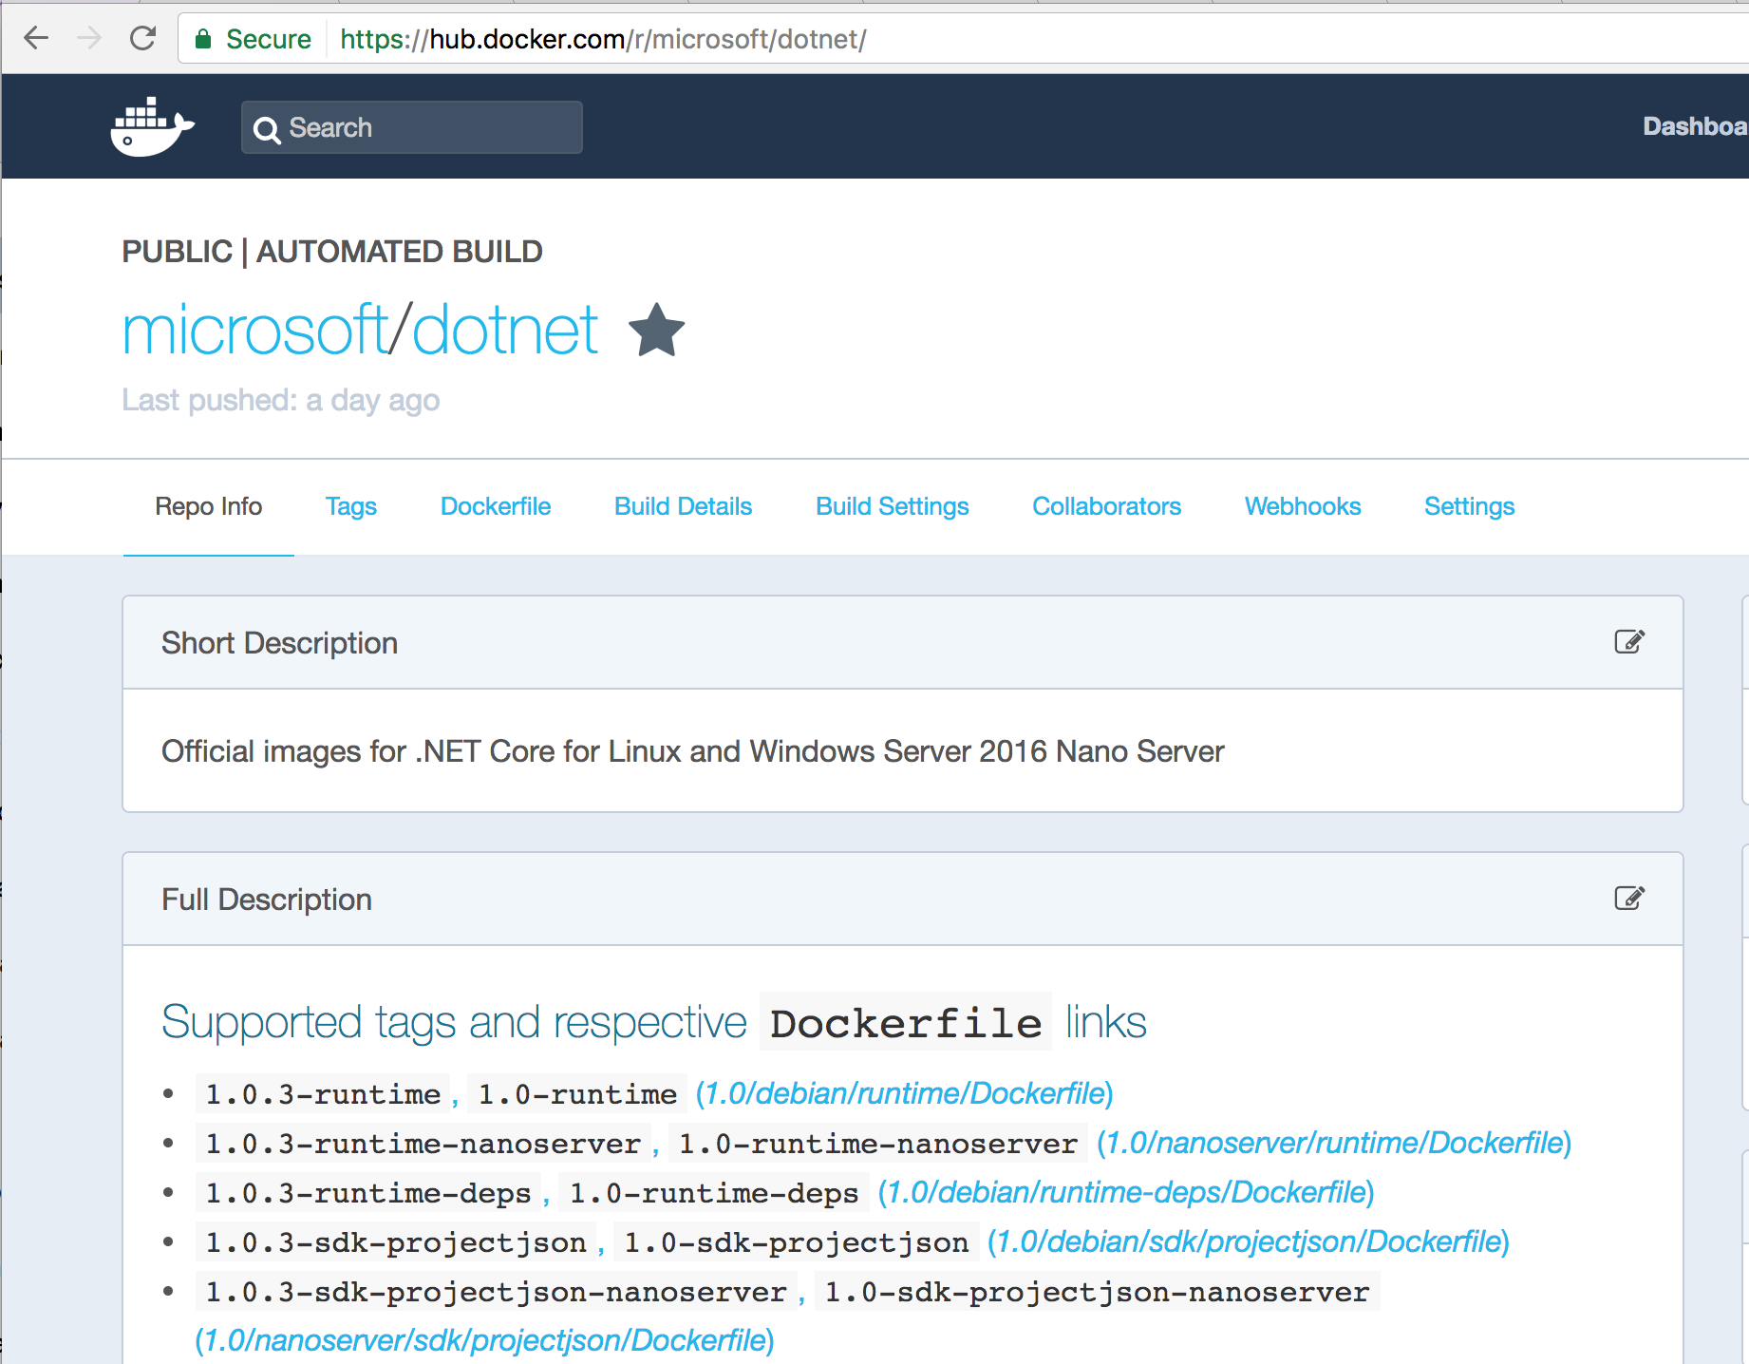

Slide 16

.NET Core
Cross-platform
Windows, Linux and macOS
Fast
ASP.NET Core on .NET Core is 4x faster than Node.js in TechEmpower benchmark
Lightweight
No impact deployment and a modular development model perfect for containers
Open source
Runtime, libraries, compiler, languages and tools developed in the open in GitHub

Slide 17
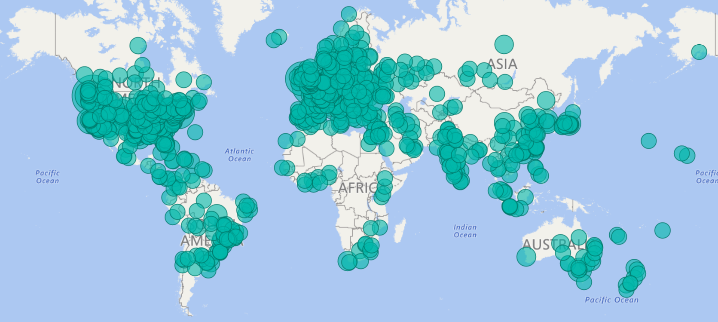
.NET Open Source Contributions as of 2016

Slide 18

Get .NET Core
Install the .NET Core SDK (https://dot.net)
Install Visual Studio (https://visualstudio.com)
Visual Studio
Windows
Visual Studio for Mac
macOS
Visual Studio Code
Windows, macOS, Linux

Slide 19
Getting Started with .NET Core
Notes:
dotnet new console
dotnet run
dotnet .dll
dotnet build

Slide 20
.NET Core Command Line Interface (CLI)
> dotnet new console // creates new project
> dotnet restore // restore NuGet dependencies
> dotnet build // builds your source into dlls
> dotnet path-to/yourapp.dll //loads and runs
> dotnet run // same thing as the last 2 lines
> dotnet add // add package or project references
> dotnet test // runs your tests;reports pass/fail
> dotnet publish // prepares app for distribution
> dotnet pack // packages library as NuGet package

Slide 21
ASP.NET Core
Fast & lightweight web framework built for .NET Core
Build modern web apps
MVC apps, Web APIs, SPAs, mobile apps, microservices, docker, real-time (future)
Integrates seamless with Azure cloud services
Azure App Services, SQL Azure, Azure Key Vault, Azure Application Insights, Azure Active Directory, etc.
Or run it on premise, on Google App Engine, on AWS, etc.
Powerful security features
HTTPS, identity, data protection, OpenID Connect, JWT, CORS, 2-factor auth, social logins
Simple composable infrastructure
Dependency injection, middleware, configuration, logging, localization, routing, session, error handling

Slide 22
Getting Started with ASP.NET Core
Notes:
dotnet add package Microsoft.AspNetCore
dotnet restore
Wire up ASP.NET Core hosting in Program.cs
Run it and browse
dotnet new web
dotnet restore

Slide 23
Try it! Lab #1

Slide 24
ASP.NET Core basics
Hosting
Middleware
Dependency Injection
Configuration
Logging

Slide 25
Configuring hosting properties
Server
Server URLs
Startup
Content root
Web root
Environment
Application name

Slide 26
Hosting
Kestrel is not yet hardened for internet facing traffic
Run Kestrel behind a mature reverse proxy
Ex IIS, Nginx, Apache, etc.
Proxy
Kestrel
Internet
Kestrel
Kestrel

Slide 27
Request handling
Request handling pipeline defined in startup
Use middleware to process requests
Built RequestDelegate used to handle all requests
Lots of built-in middleware
Routing, authentication, static files, diagnostics, error handling, session, CORS, localization, custom

Slide 28
RequestDelegate
public delegate Task RequestDelegate(HttpContext context);

Slide 29
Middleware
Middleware1
Middleware2
Middleware3
Request
// logic
next();
// logic
next();
// logic
// more logic
// more logic
// more logic
Response

Slide 30
Middleware
app.Use(Func<RequestDelegate, RequestDelegate> middleware);

Slide 31
Middleware
public class MyMiddleware
{
public MyMiddleware(RequestDelegate next, …) { … }
public async Task Invoke(HttpContext httpContext, …) { … }
}
app.UseMiddleware<MyMiddleware>();

Slide 32
Middleware
Notes:
Custom middleware that add environment header
Built-in middleware: static files, exception handling middleware

Slide 33
Dependency Injection
Register your services in ConfigureServices
You “Add” services
Simple built-in IoC container
Supports constructor injection only
Easily replace with your IoC container of choice (Autofac, Ninject, etc.)
Services available wherever the runtime creates stuff
Startup, middleware, controllers, filters, other services
Service lifetime
Singleton – there can be only one
Scoped – one per “scope” (typically a request)
Transient – always fresh!

Slide 34
Configuration

Slide 35
Logging

Slide 36
Try it! Labs #3-5

